Slide 1



Slide 2
Overview
Netflix is Media service provider, most famous for bringing to us THE OFFICE. Thank lord.(and 6000 other titles, No biggie)
Founded : 29 August 1997
2018 4th quarter market capitalization of $100 billion
As of April 2019, Netflix had over 148 million paid subscriptions worldwide, including 60 million in the United States, and over 154 million subscriptions total including free trials.
Revenue : $15.8 billion (2018)

Slide 3
History
It was founded by two software engineers (Reed Hastings, Marc Rudolph). It was initially a service which let people rent movies over the internet in 1997.
In 1999 it evolved into a monthly subscription model, which it uses till date. The subscription let you rent unlimited movies for that month.
Starting in 2007 Netflix moved into streaming media content. This saw the subscription numbers sky rocket and hit a total of 20 million subscribers I 2010.
Netflix took a huge risk with investing a whopping $100 million into its first of many original series called *drum roll* House of Cards. This gamble paid off and earned Netflix 8 Emmys that year and put Netflix on the map for many people.

Slide 4
IPO
Netflix first IPO offering : May 23, 2002
First IPO stock price : $15 per share
First day closing : $16.75
As of Yesterday June 28th the closing price for NFLX was $367.32
If purchased 66 shares for $990 when the first IPO was offered then current value for the same would be $24,243.12.

Slide 5
Our Objective and what and how we did it
Objective - To use machine learning techniques to analyse Netflix’s stock and to create strategies accordingly to make money.
What – As an investor looking to invest in a stock, the prediction of its price in the future is of highest value. These predictions help make decisions which make or loose money for an investor.
How –
Building and fitting the most relevant models.
Selecting the best fitting model using techniques like Random Forest.
Using the predicted values and results from this model to come up with trading strategies using Bollinger bands

Slide 6
The Models used
Linear regression
Moving Average
LSTM (Long short-term memory)
CAPM (Capital Asset pricing Model)
Garch, Kalman Filter

Slide 7
Linear Regression
Linear Regression is a predictive analysis commonly used in the field of Finance to predict stock prices for better insight into stock trading.
Linear Regression predicts the stock price by examining predictor variables and their impact on the variable to be predicted.
The simplest equation for this model is y = c + b*x
In the equation –
Y is a dependent variable, the Opening price of Netflix
X is an independent variable which helps predict the variable Y

Slide 8
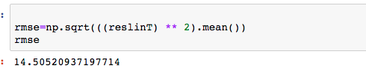
Linear Regression
RMSE for Linear is 14.50
Attached is the output for RMSE for Linear Regression

Slide 9
Moving Average
The moving average is a technical indicator which investors use to analyze price trends.
An average stock price for a fixed time period is taken and depending on the price trends either crossing this average line in an upward or downward trend a decision to short sell or long sell can be made.
This strategy is called the crossovers strategy.
When a stock price increases it makes seems the better the market is but in reality the more Bullish a market gets the chances for it dropping and become bearish increase as well.
The vice versa is true as well.

Slide 10
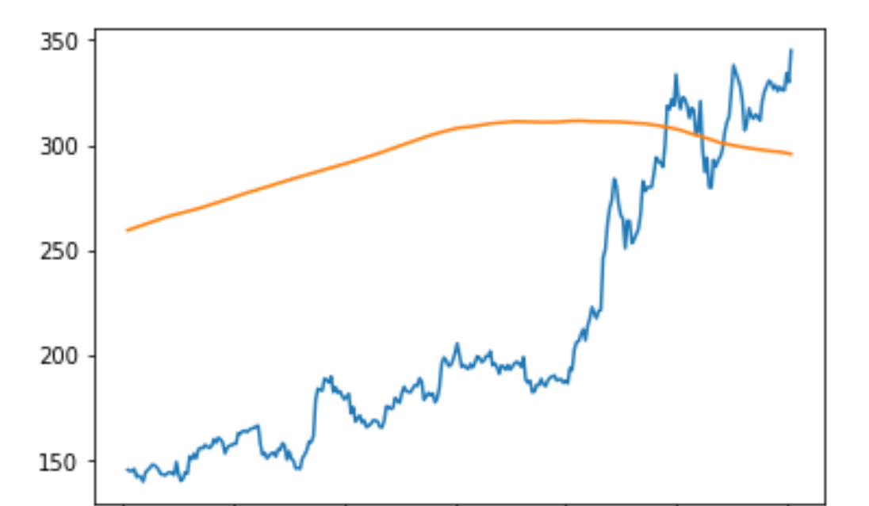
Moving Average Model

Slide 11
GARCH (generalized autoregressive conditional heteroskedasticity) and GARCH T
The H in GARCH is Heteroskedasticity it describes the irregular pattern of variation of an error term, or variable, in a statistical model. Essentially, where there is heteroskedasticity, observations do not conform to a linear pattern. Instead, they tend to cluster. The result is that the conclusions and predictive value one can draw from the model will not be reliable. GARCH is a statistical model that can be used to analyze a number of different types of financial data, for instance, macroeconomic data. Financial institutions typically use this model to estimate the volatility of returns for stocks, bonds and market indices. They use the resulting information to help determine pricing and judge which assets will potentially provide higher returns, as well as to forecast the returns of current investments to help in their asset allocation, hedging, risk management and portfolio optimization decisions.

Slide 12
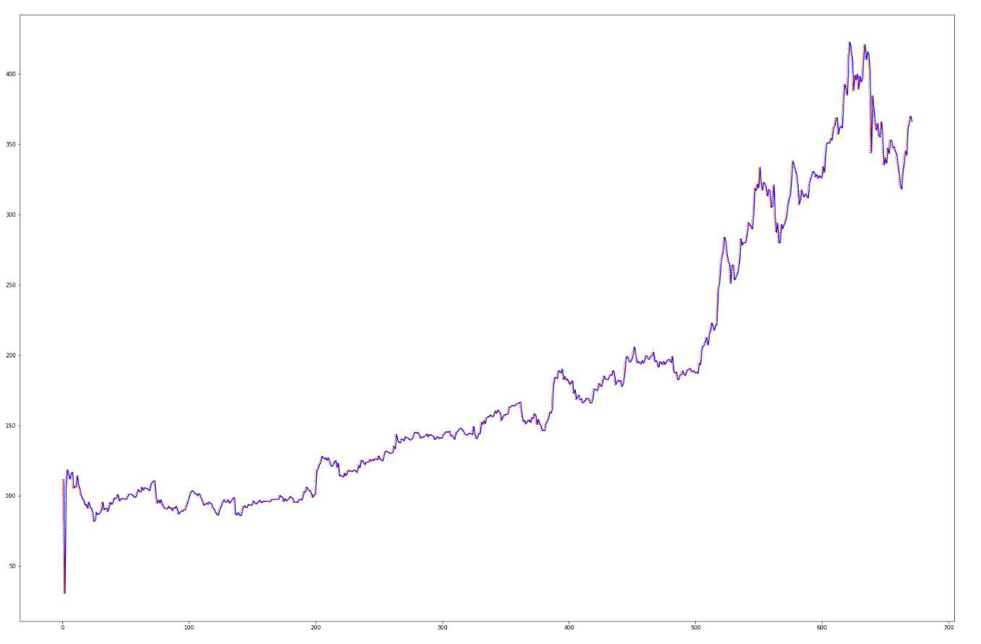
Garch Model

Slide 13
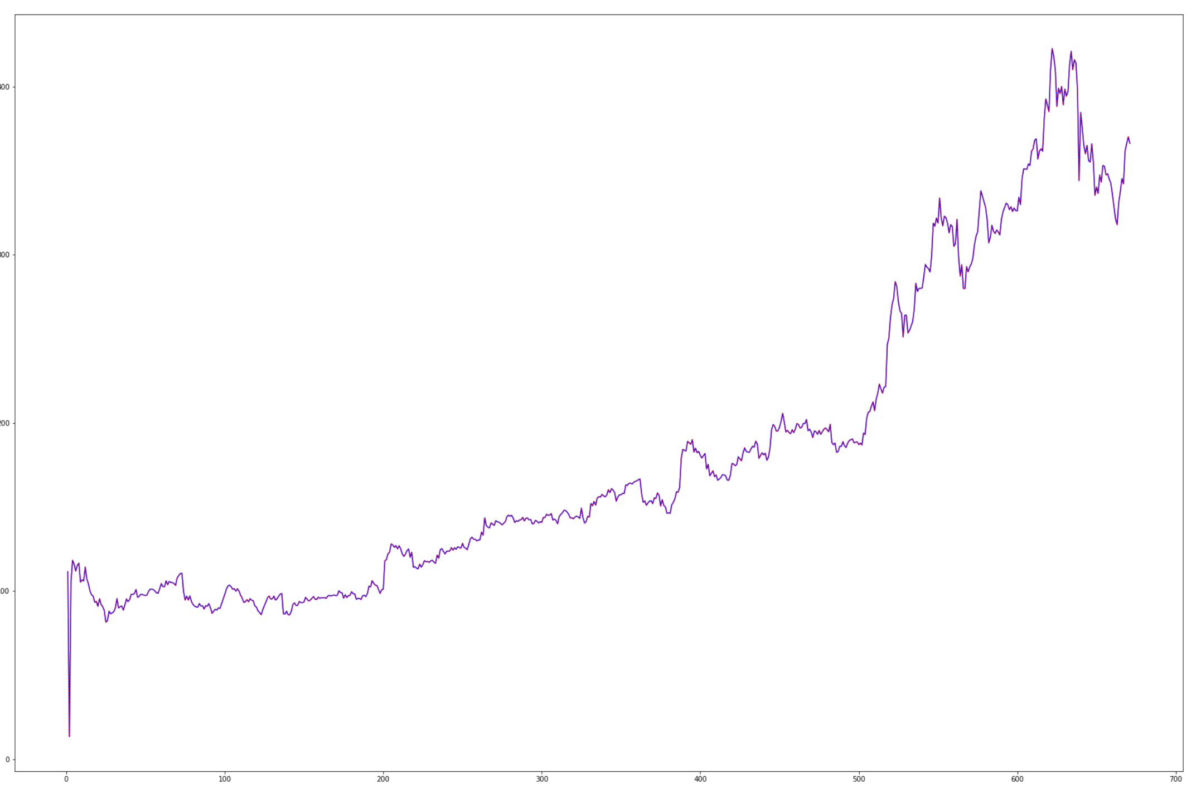
GARCH T

Slide 14
Kalman Filter
In statistics and control theory, Kalman filtering, also known as linear quadratic estimation (LQE), is an algorithm that uses a series of measurements observed over time, containing statistical noise and other inaccuracies, and produces estimates of unknown variables that tend to be more accurate than those based on a single measurement alone, by estimating a joint probability distribution over the variables for each timeframe.

Slide 15
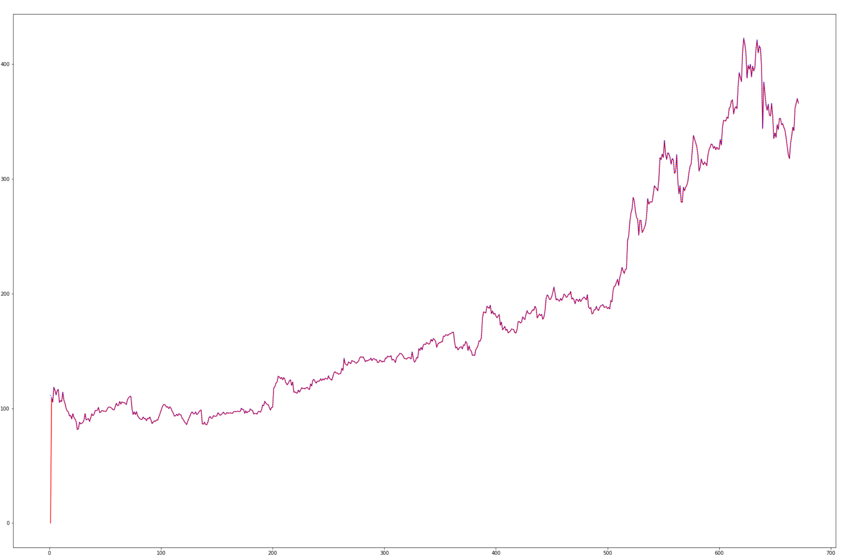
Kalman filter model

Slide 16
Random forest
Random forest is based on decision trees, where each node considers a certain feature chosen according to its improvement on a given loss function. Since decision trees tend to over-fit their training set, random trees add a random part in that several decision trees are generated from bootstrap samples of data and then averaged. In the process, the variance is greatly reduced at the price of a slight increase in bias, producing a more robust model.

Slide 17
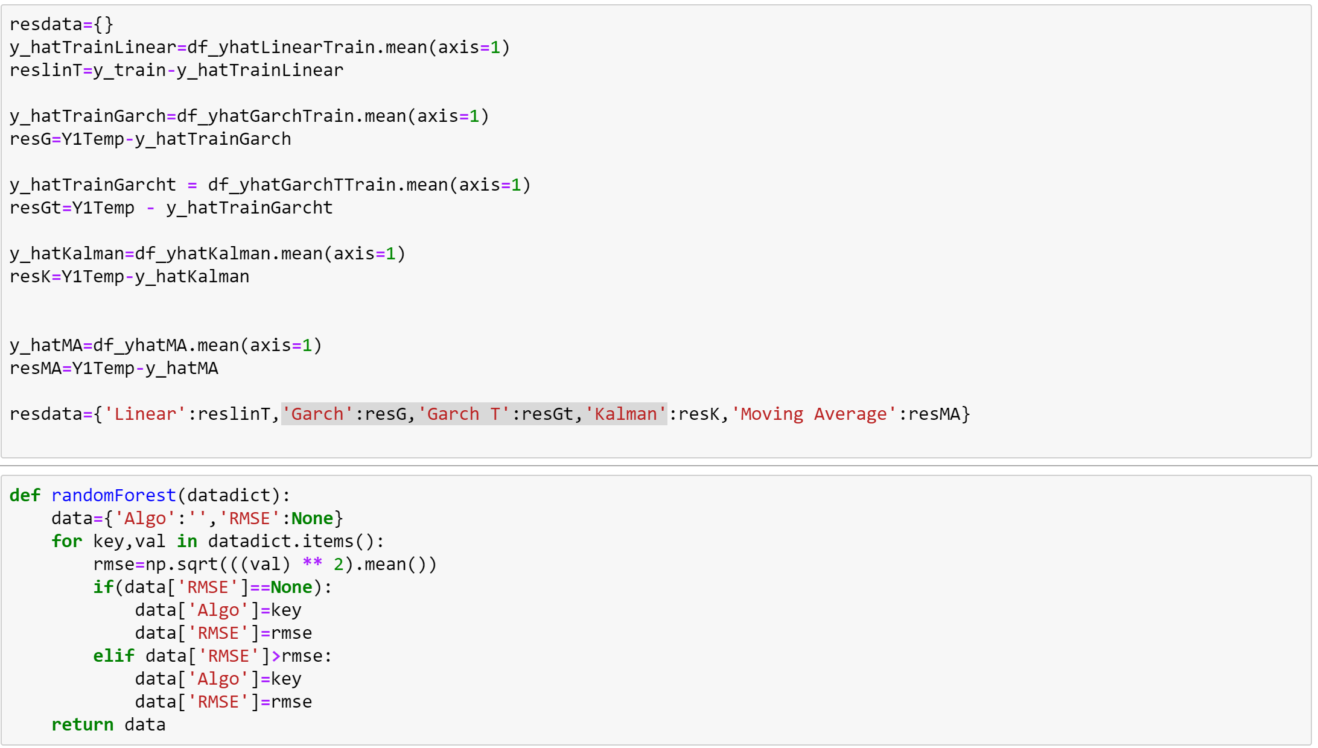
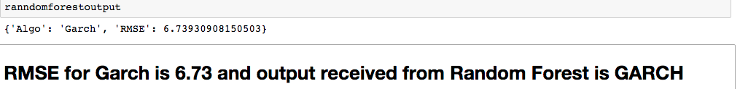
Random forest output and code
Using the output and RMSE values from the models explained earlier and plugged into the random forest algorithm, we find that the Garch model is the most optimum for out data.
It has the lowest RMSE value of 6.73.

Slide 18
Bollinger Bands
Bollinger Bands are curves drawn in and around the price structure usually consisting of a moving average (the middle band), an upper band, and a lower band that answer the question as to whether prices are high or low on a relative basis.
They are a technical analysis tool, specifically they are a type of trading band or envelope. Trading bands and envelopes serve the same purpose, they provide relative definitions of high and low that can be used to create rigorous trading approaches, in pattern recognition.

Slide 19
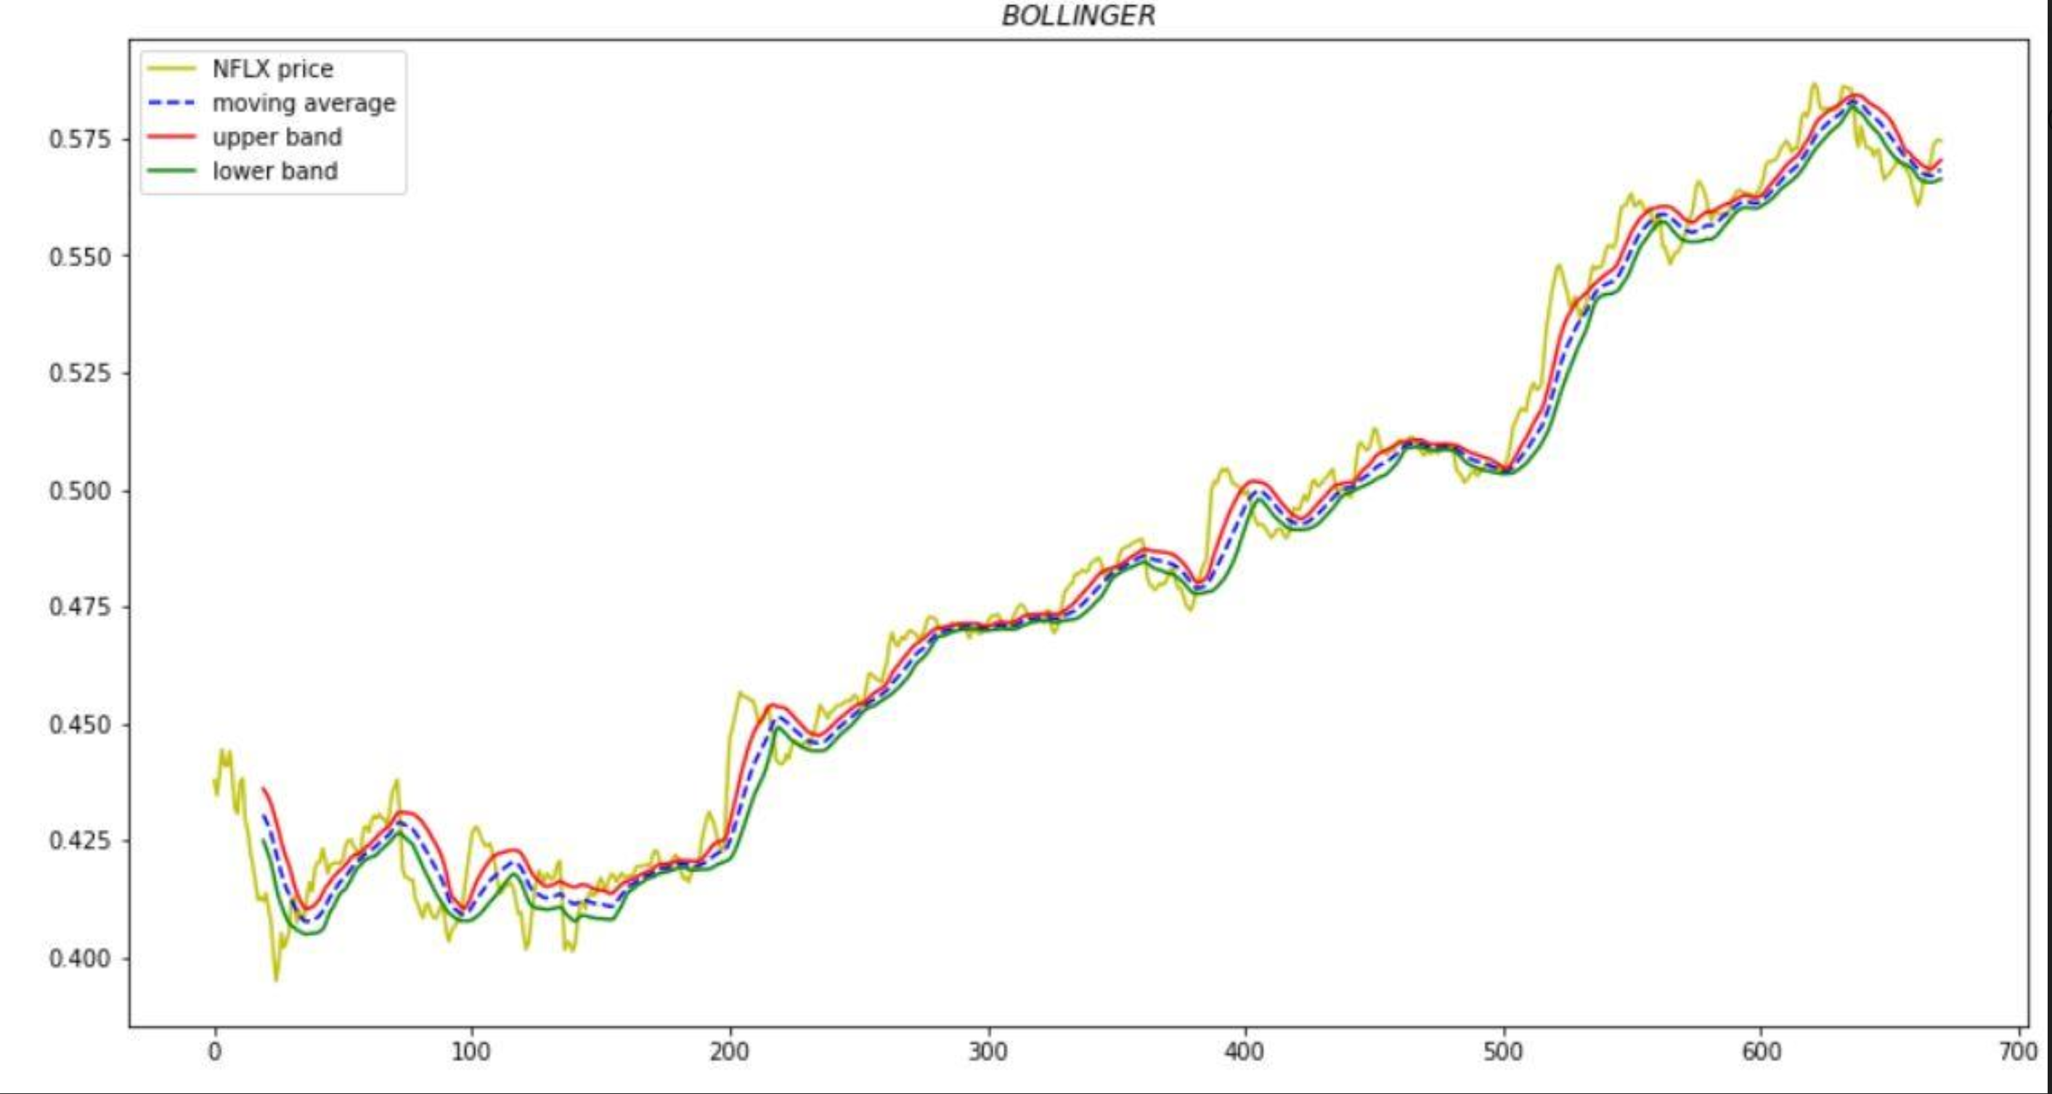
Bollinger Bands with half standard deviation

Slide 20
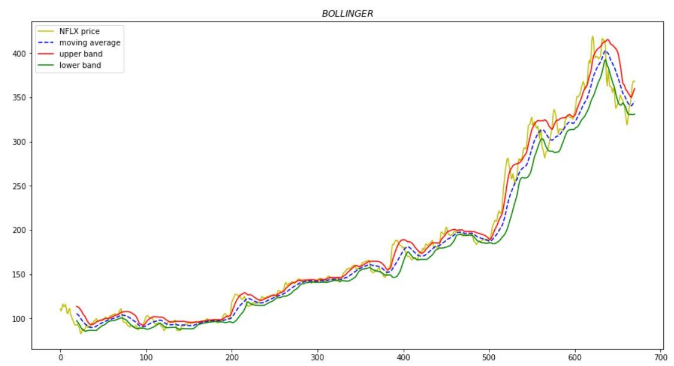
Bollinger Bands with one standard deviation

Slide 21
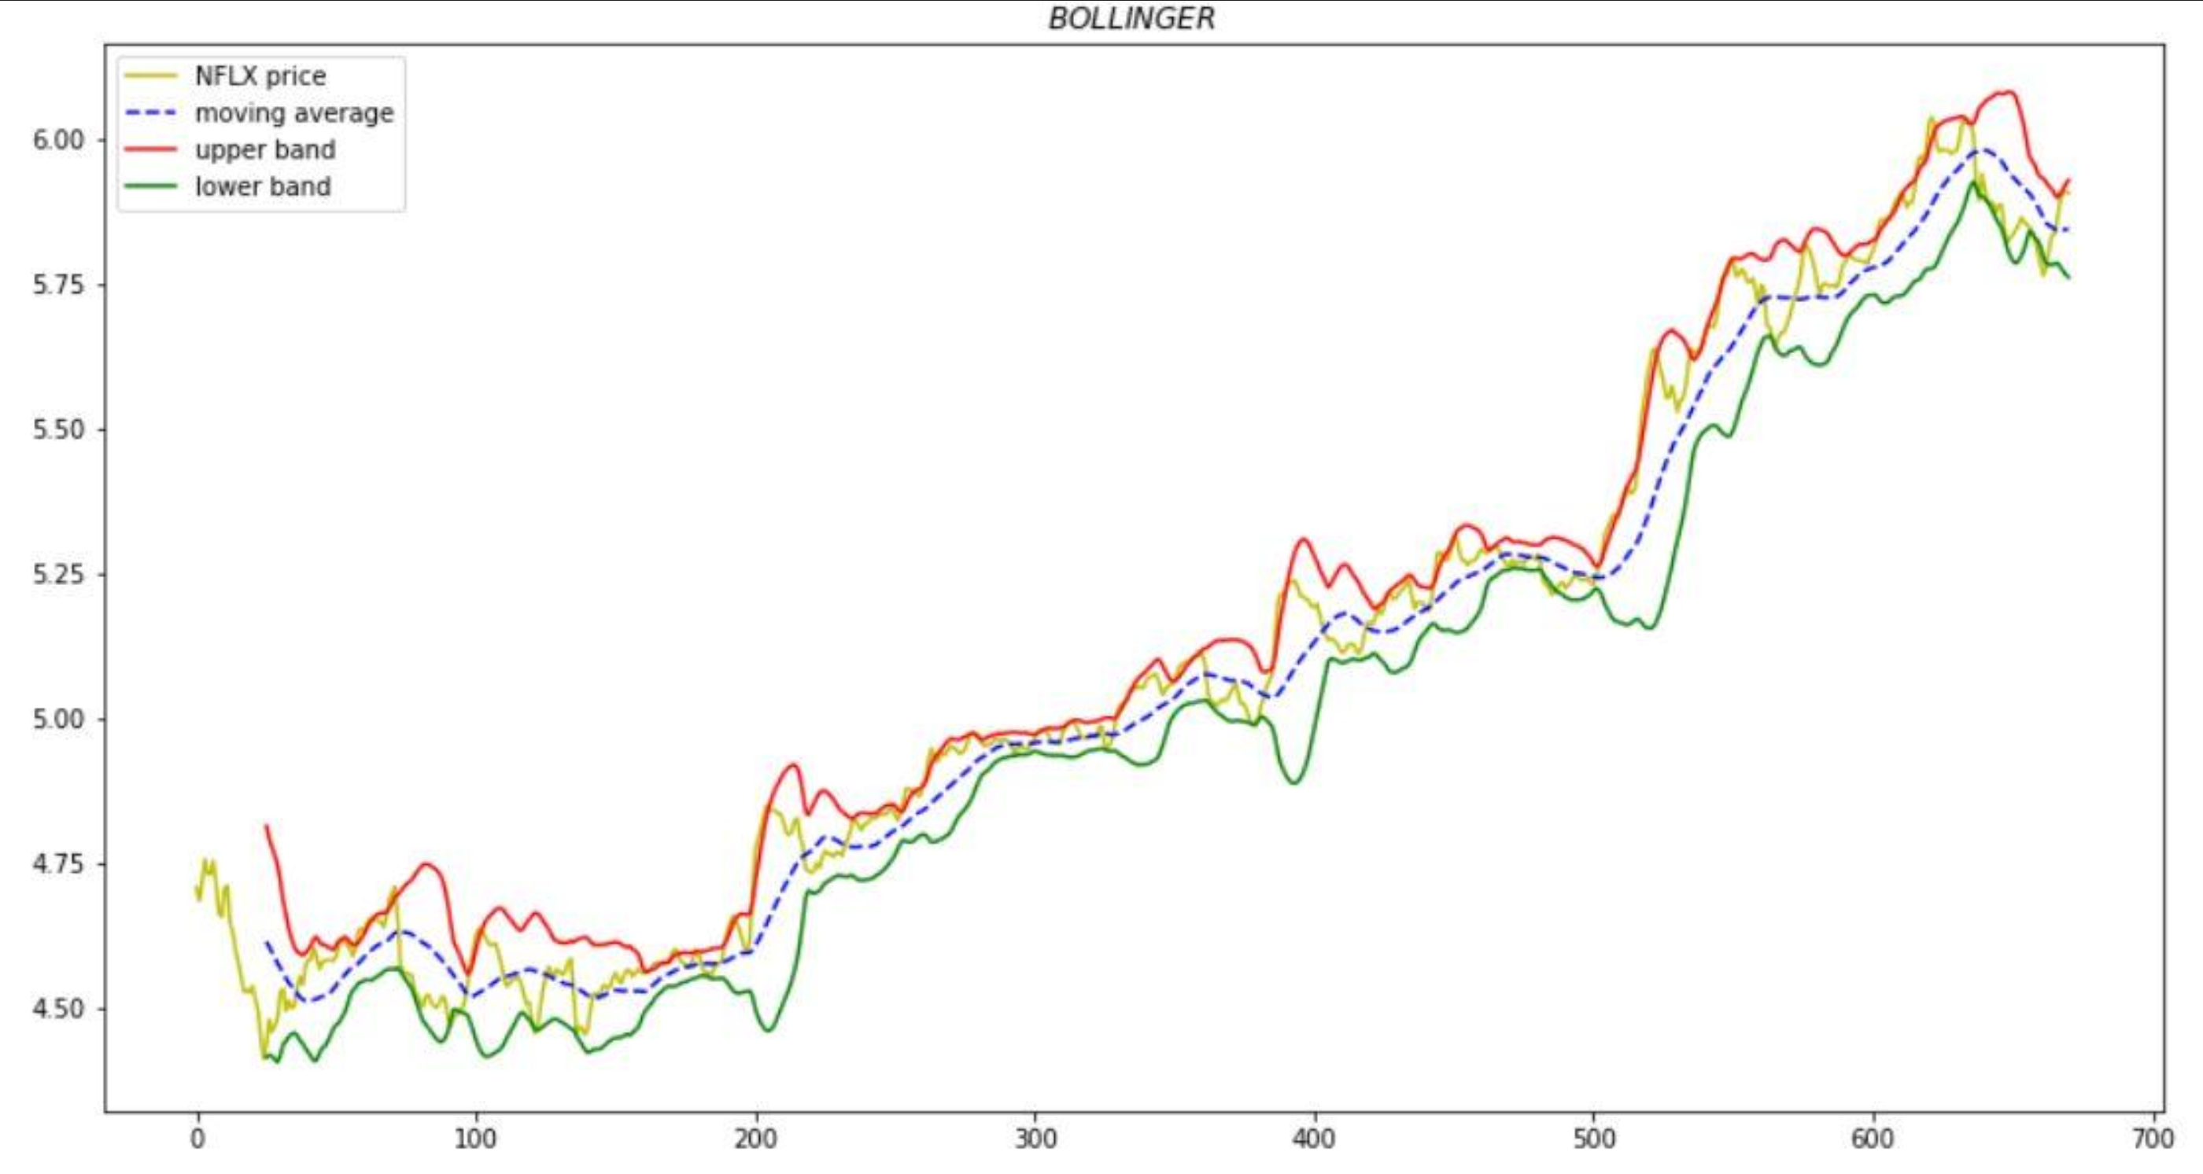
Bollinger Bands with two standard deviation

Slide 22
Next big steps and competitors
With any company with global aspirations Netflix too is looking to expand in the Asian market.
Netflix is facing competition in the domestic market with content providers like NBC, HBO and Disney all launching their own services and pulling their content off of Netflix at the end of their leases.
Netflix is looking into maintaining its grip on the market by diversifying into different markets and by adding more of its original content like House of Cards, Stranger Things etc.

Slide 23
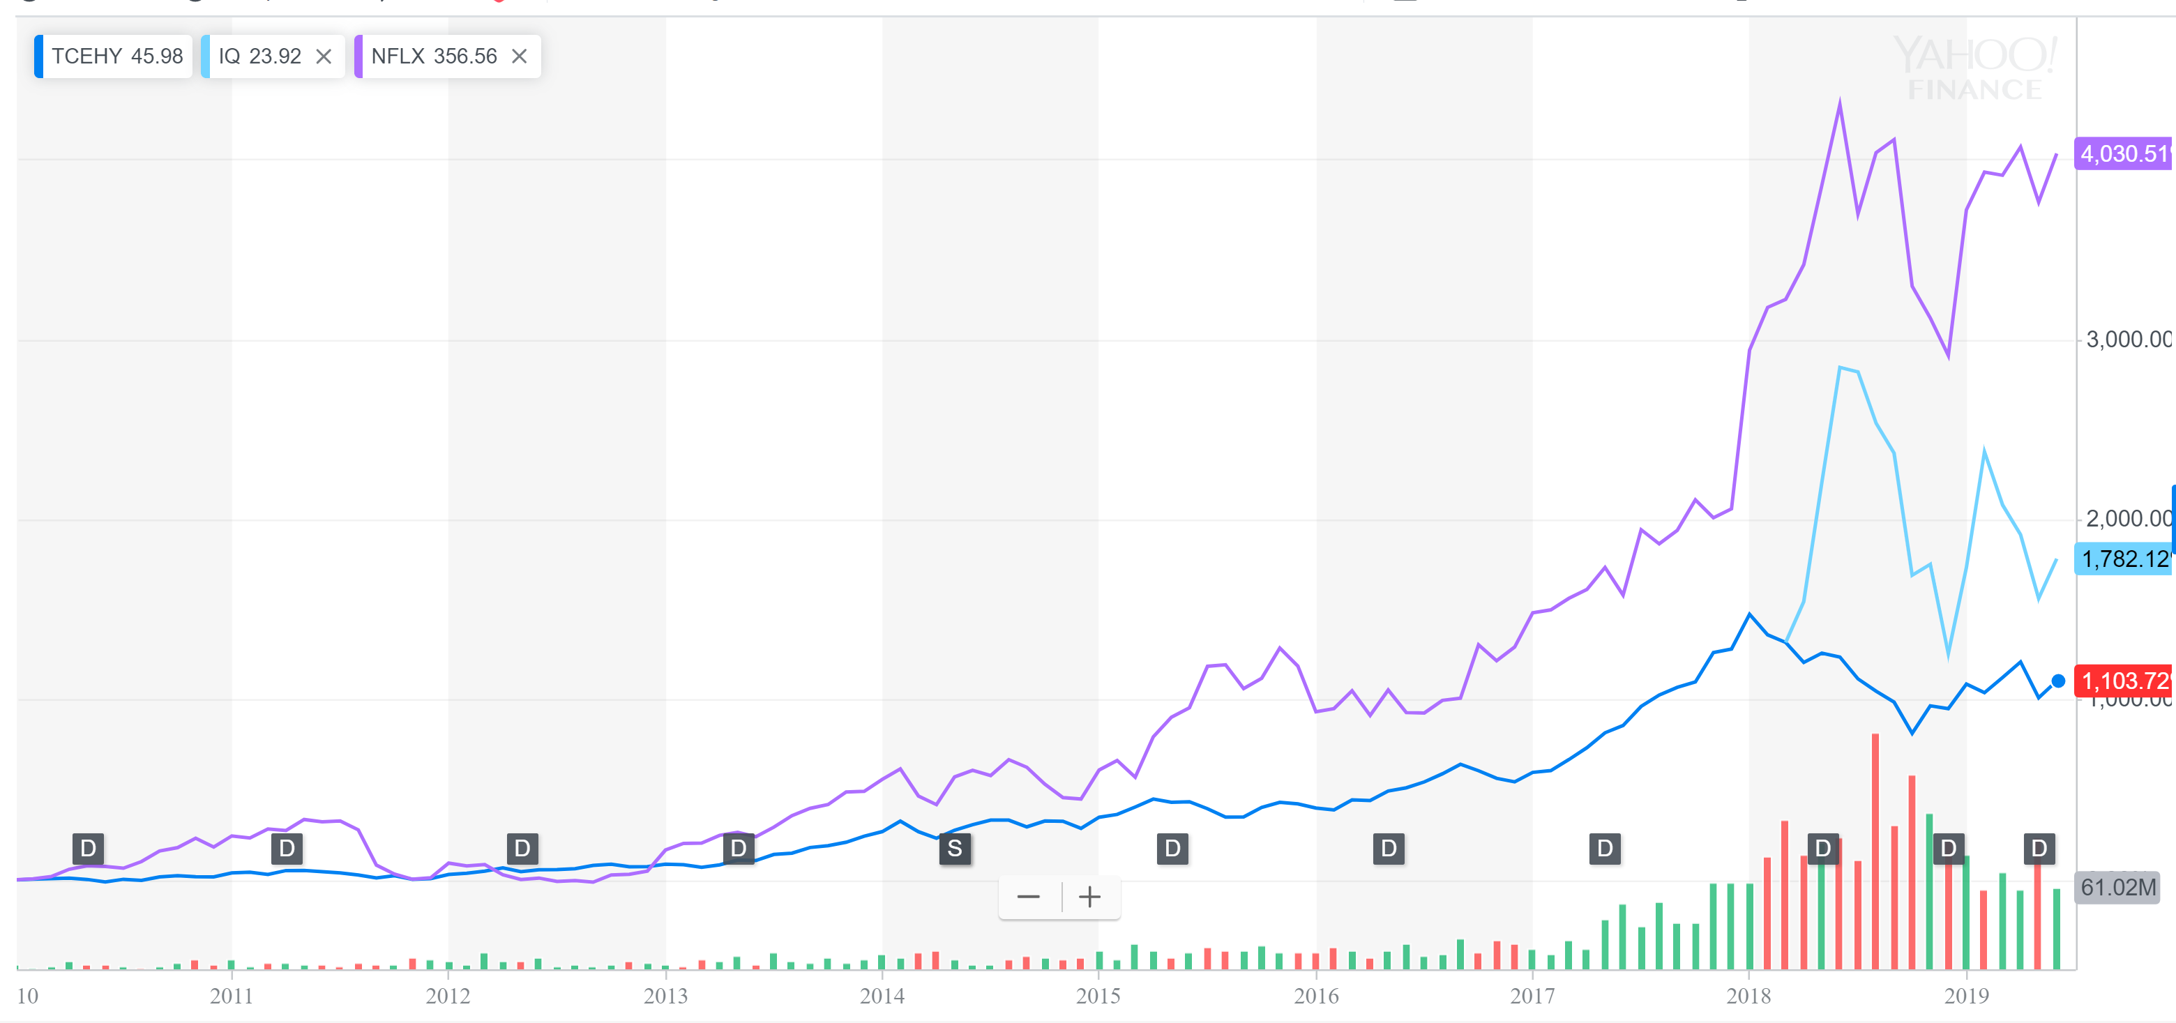
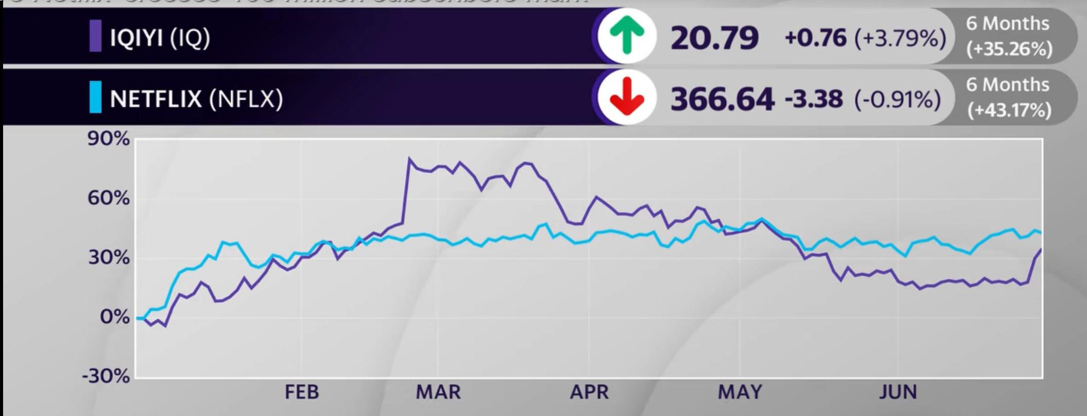
Competition
iQiyi crosses 100 million subscribers mark. It rose 58% up in stock prices in just a year.
With giants like Tencent investing in this sector with WeTv, Netflix’s ambition to expand in China and the south east Asia region in general will be difficult.
Domestically with services like HULU, Disney’s upcoming service there is competition for Netflix. However the competition has a lot of catching up to do in terms of subscribers. HULU is at 20 million while Disney is yet to launch.

Slide 24
Why you should invest?
Thanks to its HERMES translation platform, Netflix is now able to offer content in over 20 languages.
You already have.
Millennials love Netflix, with 89 percent using the service to watch most of their TV according to a survey by Business Insider.
According to internet watchdog and thinktank Sandvine, in its 2018 Internet Phenomena Report, Sandvine notes that Netflix accounted for 15 percent of all global downstream traffic volume in 2017.

Slide 25
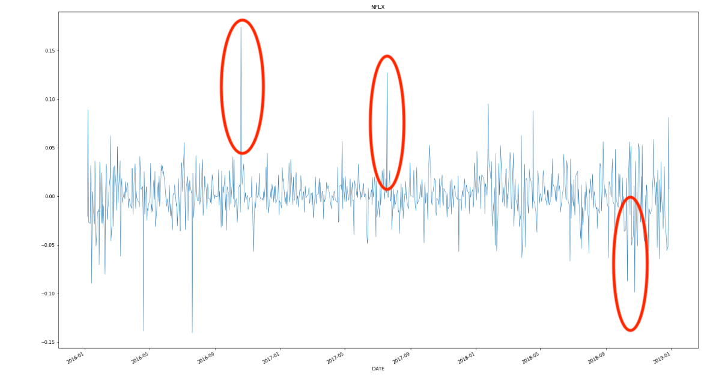
Timeline for given data
2016 Quarter 4 - Netflix added more than 7 million net subscribers during the fourth quarter of 2016—the most in the company’s history. About 5.1 million signed up from outside the US.
2017 – Netflix 8 billion on new content leading to new subscribers
2018 - Due to increase in their prices and reaching their US consumer peak that lead to a constant fall.

Slide 26
Competitors
HBO
Amazon
Hulu
In China (iQiyi, WeTV)
In India (Hotstar)

Slide 27
Thank You !!
By
Ritvic Chauhan
Rohit Jain
Inchara Niynta
Shubhangi Chanore
Yarshil Shah

Slide 28

Hold up
Insider tip watch as much of THE OFFICE as you can, they’re getting rid of it.

